Slide 1
Software Design & Development CFS2160
Week 15 – JDK, JRE & JVM

Slide 2
Session Plan
Look at the differences are between Java Development Kit (JDK) and the Java Runtime Environment (JRE)
Why we need them?
Library’s & Packages?
What is the Java Virtual Machine (JVM)?

Slide 3
The JDK
The JDK is the framework or ‘toolbox’ which we as developers use when creating Java SE (Java Standard Edition, referred to simply as Java) applications. Many of you will have seen the Microsoft .NET framework installed on your PC, JDK & JRE are the Java equivalents of that.
The JDK contains all the core elements of a Java programme, for a GUI it could include such objects as buttons and text fields, for the code it would contain all the packages we can use or import such as java.utils.ArrayList, we see it in action below.
import java.util.*;
The JDK also contains the Java compiler and all development tools to create your programme.
If we wish to use an ArrayList in our programme, we need to import the relevant package into our code to make the programme aware of our desire to use ArrayList.
If we require any functionality other than the default, we need to import it as above then we can use the functionality as needed.

Slide 4
The JRE
The Java Runtime Environment (JRE) is similar to the JDK in that it contains the packages used in a Java programmes. So why do we need JRE AND JDK?
JRE is installed on the machine where we want our released application to run.
The JRE has a component called the Java Virtual Machine (JVM) which is installed when you install the JRE. The JVM is a virtual container which is launched on your computer when you run a Java application, your application runs inside an instance of the JVM.
We use the JRE to allow our application to be platform independent, this essentially means we can create our application once and let the Java developers (Oracle) create a JRE for each operating system, our one application can then run on any supported operating system without any need to alter it for each operating system.
The only restriction may be that an application developed with the JDK 9 platform, may not run on a PC with JRE 7 installed if newer features are used in the code.

Slide 5
The JRE
It is fair to say that wherever we can install the JRE, then our Java programme can run on that machine.
This does not restrict us to programming for computers only, JRE can now be found in many systems from smart TV’s & cars to connected household appliances.
This is what Java was originally designed for many years ago, as far back as 1991.
Java has an acronym for this WORA.
Write Once Run Anywhere!

Slide 6
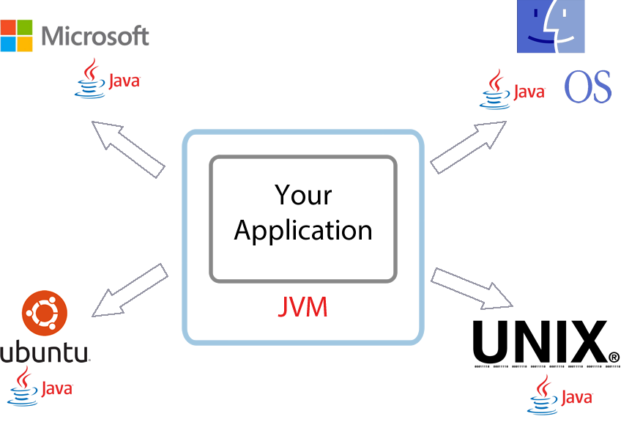
The JVM

Slide 7
What is the JDK Which are correct / incorrect and why?
The environment a Java application runs in.
The set of developer tools including the Java Compiler.
1
2
An IntelliJ plugin for Java.
Software used to create a JVM on a computer.
3
4

Slide 8
What is the JDK Which are correct / incorrect and why?
The environment a Java application runs in.
The set of developer tools and objects including the Java Compiler.
2, The JDK is the development kit which is a collection of tools and objects used to create Java programmes.
The objects can include things such as libraries for ArrayList or GUI components such as buttons and text boxes
1
2
An IntelliJ plugin for Java.
Software used to create a JVM on a computer.
3
4

Slide 9
What is the JRE Which are correct / incorrect and why?
The Java Virtual Machine
The tools a software developer uses to created an application
1
2
The software installed on a computer that allows an application to run.
A set of packages and objects used to execute and run an application
3
4

Slide 10
What is the JRE Which are correct / incorrect and why?
The Java Virtual Machine
The tools a software developer uses to created an application
3, The JRE is the software installed on a computer or machine that allows a Java programme to run. Any machine that has JRE installed can run and application developed in the correct version.
1
2
The software installed on a computer that allows an application to run.
A set of packages and objects used to execute and run an application
3
4

Slide 11
More Information
Handily, Java has a very extensive set of documentation to support the developer when using the JDK.
It contains information about all the packages, definitions and methods a Java class has. Be it an ArrayList or a simple String, there is a lot of helpful information available.
A good starting point is here https://docs.oracle.com/en/java/javase/11/
You do not need to know all about this, just where and how to use the documentation when needed.

Slide 12
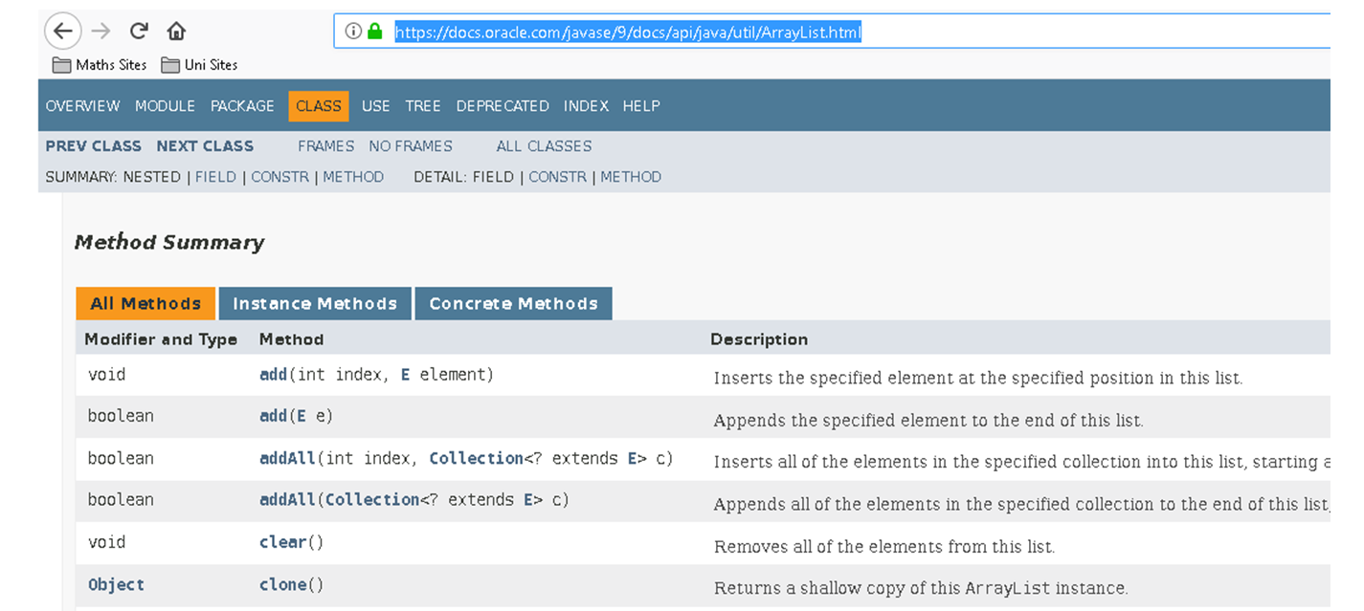
Looking at ArrayList
Start by visiting https://docs.oracle.com/javase/9/docs/api/java/util/ArrayList.html
We can view information about all the methods available in the ArrayList package, as Tony says, “We do not need to know how it works, just how to use it!”

Slide 13
Finally
Any questions about today’s session / coursework?
Have a look at the Java Documentation.
Search for a few known classes, such as String, Int etc.
See if there are any methods you recognise, read what they do and how you can use them in your code.
It is worth remembering, many of the things you wish to code in your application, probably already exist in a Java package!

